Slide 1


MACHINE LEARNING SYSTEMS REPORT
Global Crop Production Forecasting Engine
MODEL VALIDATION, REAL-TIME INTERACTIVITY & SUPPLY CHAIN INTEGRATION

Slide 2


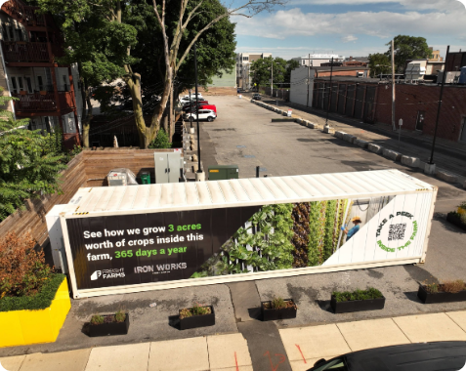
Executive Summary
Bridging Agriculture & ML Operations
Global crop production contains complex, non-linear relationships determined by regional boundaries, environmental footprints, and localized yields. Simple baseline projection systems fail to recognize these operational dynamics.
By contrasting a baseline Linear Regression (Ridge) model with an advanced Random Forest Ensemble, this deployment verification report highlights the immense business value unlocked by transitioning to highly accurate, structural systems.
✓
Validation Scope: 44,986 clean, high-fidelity rows
✓
Feature Complexity: Standard scaling paired with 360 categorical columns
✓
Infrastructure Ready: Integrated with interactive corporate systems

Slide 3




Model Performance Evaluation
Evaluation Environment | Statistical Metric | Baseline (Linear Regression) | Champion (Random Forest) | Performance Verdict
Validation Set | R² (Coefficient of Determination) | 48.42% | 97.11% | Strong non-linear recognition
Validation Set | Mean Absolute Error (MAE) | 1,782,323 Tons | 78,021 Tons | Error reduced by 95.6%
Holdout Test Set | R² (Coefficient of Determination) | Not Evaluated | 96.86% | Passed (No Overfitting)
R² Coefficient of Determination Formula:
Mean Absolute Error (MAE) Formula:

Slide 4

Why Random Forest Succeeded
The Power of Conditional Splitting
Agriculture does not grow in a straight, uniform line. A linear equation assumes that adding land area always yields the exact same volume of crops, regardless of region, technology, or item category.
96.86%
The Random Forest Champion Model handles non-linear structures using dynamic, nested decision tree networks:
✓
Contextual Branching: Looks at regional variables and soil capabilities before analyzing physical land size metrics.
Holdout Test R² Score
✓
Strict Upper and Lower Boundaries: Restricts all volume guesses to actual observed physical properties, completely eliminating impossible negative outputs.

Slide 5






Operational Business Actions
Freight Booking
Risk Sourcing
Anomaly Audits
Predict regional crop outputs months before harvest. Procurement groups can pre-book sea and rail cargo containers at lower contract rates, avoiding volatile spot markets during high seasonal bottlenecks.
Conduct quick simulated pipeline stress tests. Instantly evaluate geographic shortfalls (e.g., simulating a localized land output reduction) and locate stable alternative supplier countries.
Run automated background anomaly audits. If actual field reports significantly deviate from the model's expected harvest, the system triggers alerts for inspection of localized blights or data errors.

